Slide 1

CAMPUS TRANSPORTATION
APPLICATION
Course: CIT 38800 – 20013
Shail Desai

Slide 2






Improved Administrative Efficiency
CAMPUS TRANSPORTATION APPLICATION
The Campus Transportation Portal is a user-friendly platform facilitating student registration, route selection, and payment processing for campus transportation services. It streamlines commuting by providing real-time updates and feedback mechanisms, enhancing the overall campus transportation experience.
KEY FEATURES OF THE APPLICATION
TECHNOLOGY STACK
Streamlined Registration Process
Automated Payment Management
Real-Time Route Tracking
JAVA
ORACLE
SCENEBUILDER
Enhanced Transportation Planning
POTENTIAL USERS
Improved Administrative Efficiency
Data Collection
STUDENTS
ADMIN
ADVISORS

Slide 3

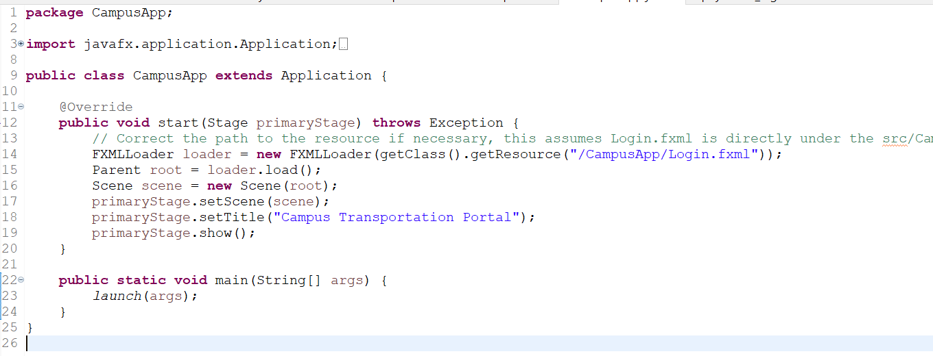

CHOICE OF IMPLEMENTATION
JAVA
SQL DEVELOPER
JAVA ECLIPSE

Slide 4
REQUIREMENTS CHECK
Classes & Application Structure
Five main classes (“DatabaseManager”, “LoginController”, “FormController”, “PaymentController”, “ReceiptController”) plus an inner class (“PaymentDetail”)
“CampusApp” class: Main application entry point using JavaFX
Object – Oriented Design (OOD) Concepts:
Inheritance: CampusApp class extends “Application”
Polumorphism: Overriding the start Method in “Application” Class.
Abstraction: Use of FXML for UI defines abstraction, separating UI design from logic.
Composite Structure: Controllers act as composite classes managing multiple UI components and data interactions.
ArrayList: Utilized in “PaymentController “ to track payment transactions
Method Overriding: Override of JavaFX’s ‘Application.start()’ and controller initializations.
Interfaces: Potential use of “Initializable” for initializing controllers.
Advanced Programming Techniques:
Exception Handling: Robust error management in Database connectivity and file operations.
File Reading/Writing: Payment Details are logged into a file for record–keeping.
GUI: The entire application runs on JavaFX, providing a graphical user – interface connected via FXML files.
User – Interactions: Complex interactions across multiple forms, including login, form submissions, and payment processing.

Slide 5
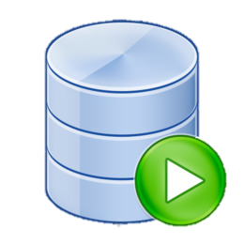

REQUIREMENTS CHECK
REQUIREMENTS CHECK CONTINUED
Practical Implementation
Database Operations: Connection handling, transactions, and SQL operations for student and payment data management.
GUI Navigation: Seamless transitions between screens based on user actions, enhancing user experience.
Oracle Database Table Names
CAMPUS_USERS
CAMPUS_ROUTES
Stores user authentication details such as username and password, along with a system-generated unique ID for each user.
Defines various transportation routes available on campus, with each route having a unique identifier and name.
CAMPUS_STUDENTS
USER_RECEIPT
Holds information about students, including personal details (like first and last names), department affiliation, major, and scheduled campus transportation times. It links students to user accounts via a foreign key relationship with CAMPUS_USERS
Logs receipts for transactions, relating them back to payments through a foreign key to PAYMENT_DETAILS, and includes additional information like a receipt description and a date.
ROUTES
Includes pricing per month for each route, which might be used for different pricing strategies or route management scenarios.
PAYMENT_DETAILS
Tracks financial transactions related to campus services, capturing details like payment amounts, dates, methods, and associated card information.
STUDENT_ROUTES
Connects students to specific routes they use and includes information about the route type and the price per semester, facilitating the management of student transportation details.

Slide 6



TECHNICAL CHALLENGES DURING PROJECT DEVELOPMENT
Database Integration & Management
Concurrency and Multithreading
User Interface Design Consistency and Responsiveness
Error Handling and Robustness
Complex Connection Handling: Managing JDBC connections requires careful setup, error handling, and cleanup to avoid memory leaks and ensure stability.
UI Responsiveness: Implementing long-running tasks in background threads using Task or Service classes to prevent the GUI from freezing..
Cross-Platform Consistency: Designing an interface in FXML that looks and behaves consistently on different platforms and resolutions.
Comprehensive Error Capture: Developing a system to catch and handle all potential exceptions, particularly those related to database and network operations..
SQL Performance: Crafting efficient SQL queries and properly indexing the Oracle database to prevent slow response times and optimize data retrieval.
Data Synchronization: Managing data consistency between the UI thread and background threads to avoid race conditions and data corruption.
Responsive Design: Implementing dynamic resizing and scalable components to ensure the GUI adapts well to different screen sizes and orientations.
User-Friendly Error Messages: Displaying clear and informative error messages to users, guiding them on how to proceed or correct issues without confusion.
Thread Safety: Managing data consistency between the UI thread and background threads to avoid race conditions and data corruption.
Transaction Management: Ensuring transactions are correctly managed to maintain data integrity, especially in multi-user environments where concurrent data access is common.
Intuitive Navigation: Creating a logical and easy-to-navigate UI layout that enhances user experience and facilitates quick access to the application's features.
Reliability & Testing: Implementing thorough testing strategies, including unit and integration tests, to identify and mitigate errors early in the development cycle.

Slide 7

UI PAGE DESIGNS
1.
2.
3.
4.
Username
Login
Login - Page
Student Details Page
Payment Details Page
Receipt Details Page
=
UI Designs had to be simplified because more professional UI design required more development time.
=
JavaFX and FXML changes required many changes to the controller codes causing huge delays in testing, FXML code required lot of debugging time.
=
The UI design shown in the Project Proposal was not met because it would require more study of JavaFX and FXML.
=
Despite changes in the design, functionality remains the same, and user inputs and data operations are also same.

Slide 8


PROJECT REFLECTION
Applied Oracle Database skillsets for the database operations on the Campus Transportation Application.
Learned how JDBC works with Java Eclipse
Learned how to retrieve data from Oracle Database based on UserID using Java Backend Code.
Learned how to best utilize JavaFX and Screenbuilder (FXML) to create basic UI Designs.
Complex UI design requires more development time and more understanding of the JavaFX Framework.
Continuous Testing allows UI design to be managed easily.
Learned the core principles of Java Programming, including Polymorphism, Abstraction, File Reading/Writing etc.
Got the opportunity to create an application that can justify as a real – world application for Campus Student.

Slide 9


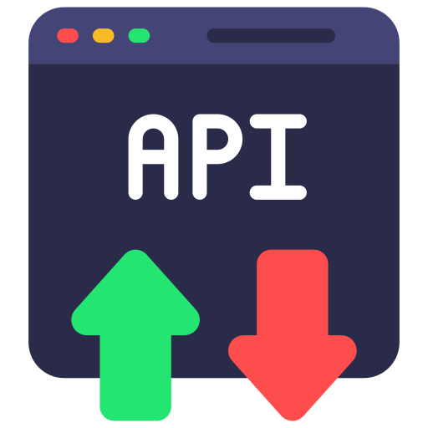

FUTURE PROJECT IMPLEMENTATIONS
Mobile App
Data Security
AI Algorithm
API’s
Create an Mobile Application using Android Studio.
Add more Data Security Logic to further strengthen User Data Security
Integrate AI algorithms to make returning user experience simpler and easier.
Retrieve Data from external sources quicker and faster.
This change will allow users to complete the process faster and in an efficient manner.
Add more Cybersecurity handling
Integrate NoSQL Database for maps and coordinates integration.
Auto – Populate insert fields using Student ID.

Slide 10
THANK YOU

